Slide 1
HouseMe
New Marketing Strategy
Ishak
Sébastien
Giuliano
Pierro

Slide 2
Intro – Who are we?
I- A Client Segmentation
1. Age
2. Sex
3. Firm & Physical persons
4. Satisfaction
5. Others
II- Unsold/ Stock
Kind of apprtment
Target
II – Strategy
1. Target
2. Mortgage Services
3. Communication Channels
4. Dates
Marketing Campain

Slide 3

HouseMe
Real Estate Firm
Average of 1,000 ft² appartment
Based in USA

Slide 4

I- Client Segmentation
1. Age & Sexe
2.Firm & Physical Person
3. Satisfaction
4. Others

Slide 5

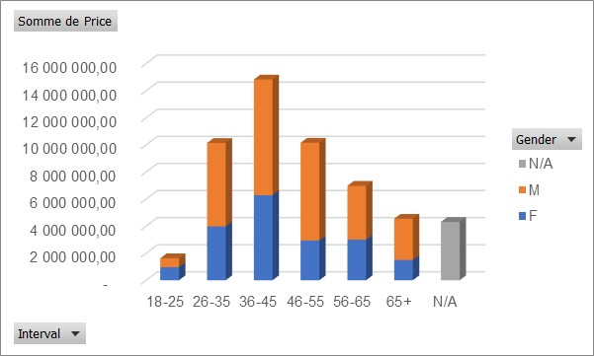
I- Client Segmentation 1. Age & Sexe
Age: More 36-45

Slide 6

2. Firm & Physical Person
More Physical Person
Their is a big firm: …

Slide 7

3. Satisfaction
……………….;;
……;

Slide 8
4. Others
………………
……………..

Slide 9

II- Unsold/ Stock
2. Target
…… can buy that
Kind of appartement
….. Ft²
Prices: …..

Slide 10

II – Strategy
1. Target
2. Mortgage Services
3. Communication Channels
4. Dates

Slide 11

1. Target
erererere

Slide 12

2. Mortgage Services
………………..

Slide 13

3. Communication Channels
Website

Slide 14

4. Dates
…………..;;;
………..;;;

Slide 15

III- Marketing Campain
1. Target
2. Mortgage Services
3. Communication Channels
4. Dates

Slide 16
Conclusion
….
…..
…..

